Slide 1
Introduction to I²C Protocol, case study in TSL2561

Slide 2
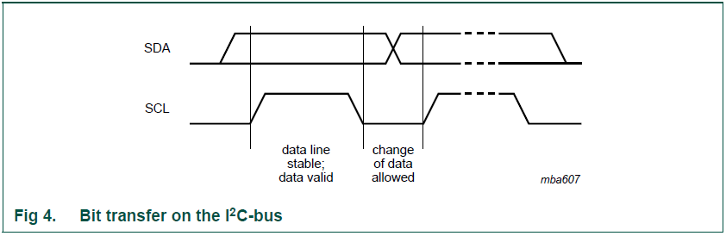
Data validity
The data on the SDA line must be stable during the HIGH period of the clock. The HIGH or LOW state of the data line can only change when the clock signal on the SCL line is LOW (see Figure 4). One clock pulse is generated for each data bit transferred.

Slide 3
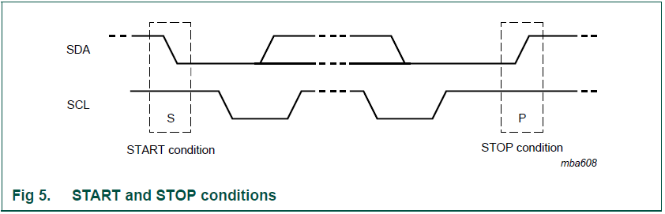
START and STOP conditions
All transactions begin with a START (S) and are terminated by a STOP (P) (see Figure 5).
A HIGH to LOW transition on the SDA line while SCL is HIGH defines a START condition.
A LOW to HIGH transition on the SDA line while SCL is HIGH defines a STOP condition.

Slide 4
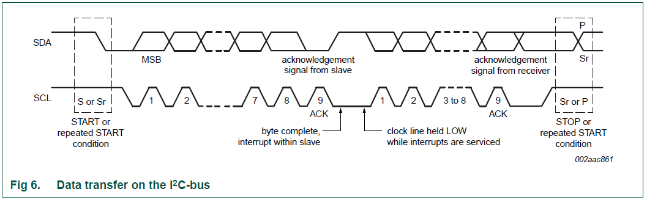
Byte format
Every byte put on the SDA line must be eight bits long. The number of bytes that can be transmitted per transfer is unrestricted. Each byte must be followed by an Acknowledge bit. Data is transferred with the Most Significant Bit (MSB) first (see Figure 6). If a slave cannot receive or transmit another complete byte of data until it has performed some other function, for example servicing an internal interrupt, it can hold the clock line SCL LOW to force the master into a wait state. Data transfer then continues when the slave is ready for another byte of data and releases clock line SCL.

Slide 5
Clock synchronization
Two masters can begin transmitting on a free bus at the same time and there must be a
method for deciding which takes control of the bus and complete its transmission. This is
done by clock synchronization and arbitration. In single master systems, clock
synchronization and arbitration are not needed.
Clock synchronization is performed using the wired-AND connection of I2C interfaces to
the SCL line. This means that a HIGH to LOW transition on the SCL line causes the
masters concerned to start counting off their LOW period and, once a master clock has
gone LOW, it holds the SCL line in that state until the clock HIGH state is reached (see
Figure 7). However, if another clock is still within its LOW period, the LOW to HIGH
transition of this clock may not change the state of the SCL line. The SCL line is therefore
held LOW by the master with the longest LOW period. Masters with shorter LOW periods
enter a HIGH wait-state during this time.

Slide 6
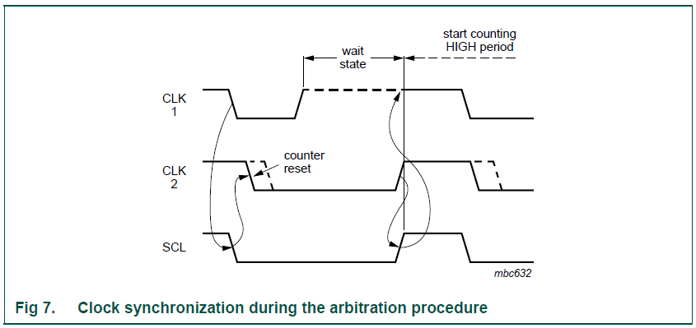
Clock synchronization

Slide 7
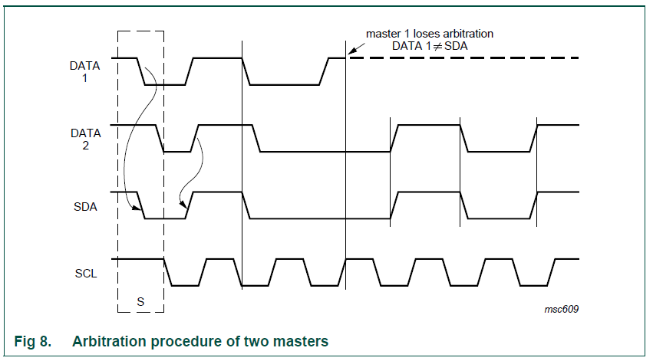
Arbitration
Arbitration proceeds bit by bit. During every bit, while SCL is HIGH, each master checks to see if the SDA level matches what it has sent. This process may take many bits. Two masters can actually complete an entire transaction without error, as long as the transmissions are identical. The first time a master tries to send a HIGH, but detects that the SDA level is LOW, the master knows that it has lost the arbitration and turns off its SDA output driver. The other master goes on to complete its transaction.

Slide 8
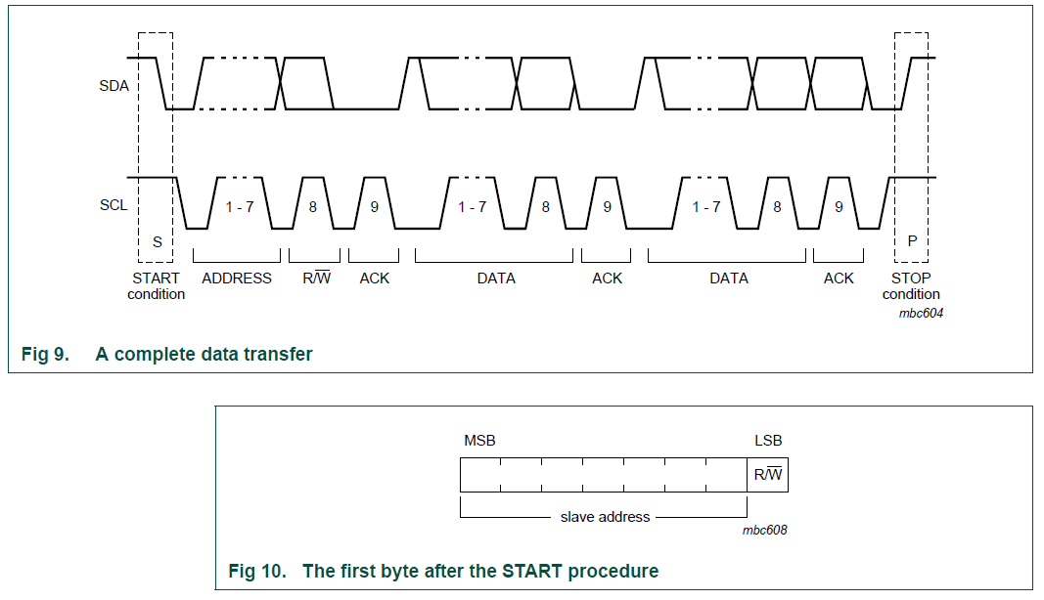
The slave address and R/W bit
Data transfers follow the format shown in Figure 9. After the START condition (S), a slave address is sent. This address is seven bits long followed by an eighth bit which is a data direction bit (R/W) — a ‘zero’ indicates a transmission (WRITE), a ‘one’ indicates a request for data (READ) (refer to Figure 10). A data transfer is always terminated by a STOP condition (P) generated by the master. However, if a master still wishes to communicate on the bus, it can generate a repeated START condition (Sr) and address another slave without first generating a STOP condition. Various combinations of read/write formats are then possible within such a transfer.

Slide 9
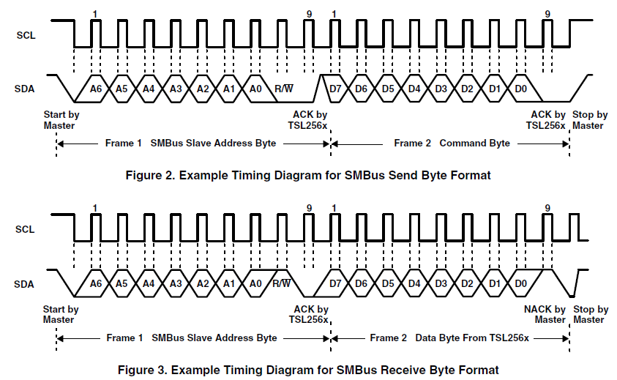
TSL2561 Protocol

Slide 10
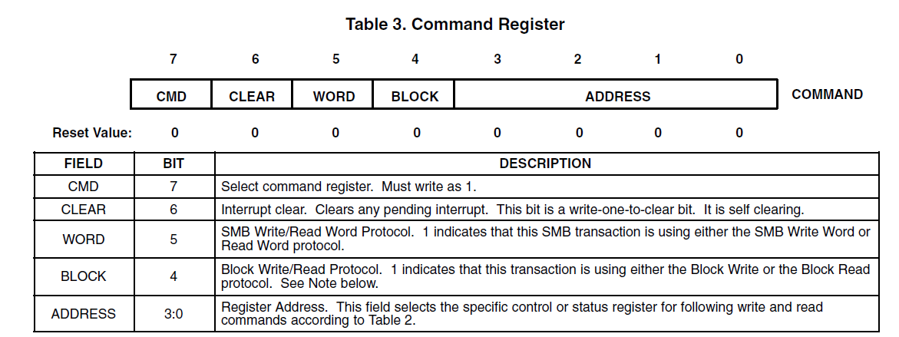
TSL2651 Command Register

Slide 11
Arduino Wire TSL2561
bool ReadByte(uint8_t addr, uint8_t & value) {
Wire.beginTransmission(TSL2561_ADDR);
Wire.write(addr | TSL2561_CMD);
error = Wire.endTransmission();
if (error == 0) {
Wire.requestFrom(TSL2561_ADDR, 1);
if (Wire.available() == 1) {
value = Wire.read();
return (true);
}
}
return (false);
}
bool WriteByte(uint8_t addr, uint8_t value)
{
Wire.beginTransmission(TSL2561_ADDR);
Wire.write(addr | TSL2561_CMD);
Wire.write(value);
error = Wire.endTransmission();
if (error == 0)
return (true);
return (false);
}

